Slide 1



ClonifyNow
PUDO RIDE SHARING APP CASE STUDY
Transforming Shared Mobility with Smart Carpooling Solutions

Slide 2
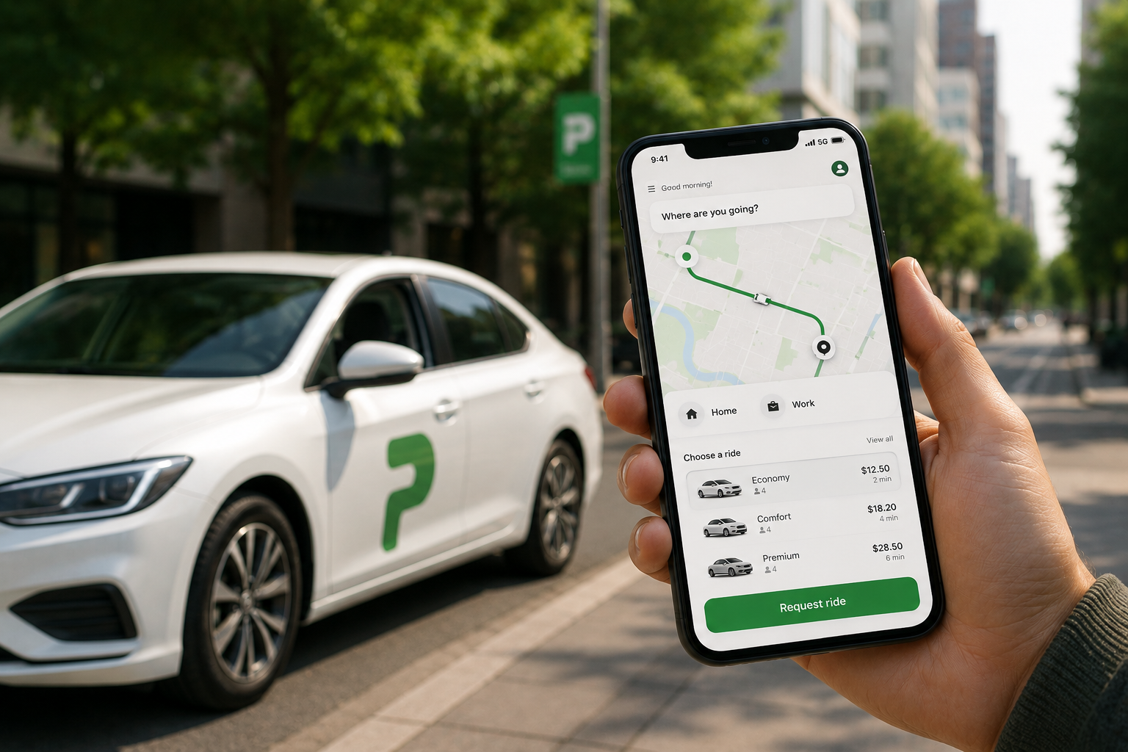

What is PUDO?
PUDO is a sophisticated mobile application platform designed to revolutionize urban and intercity transportation through intelligent ride-sharing and carpooling solutions. The platform connects riders and drivers in real-time, enabling seamless, secure, and affordable mobility solutions for commuters and travelers across multiple markets.
APP OVERVIEW

Slide 3
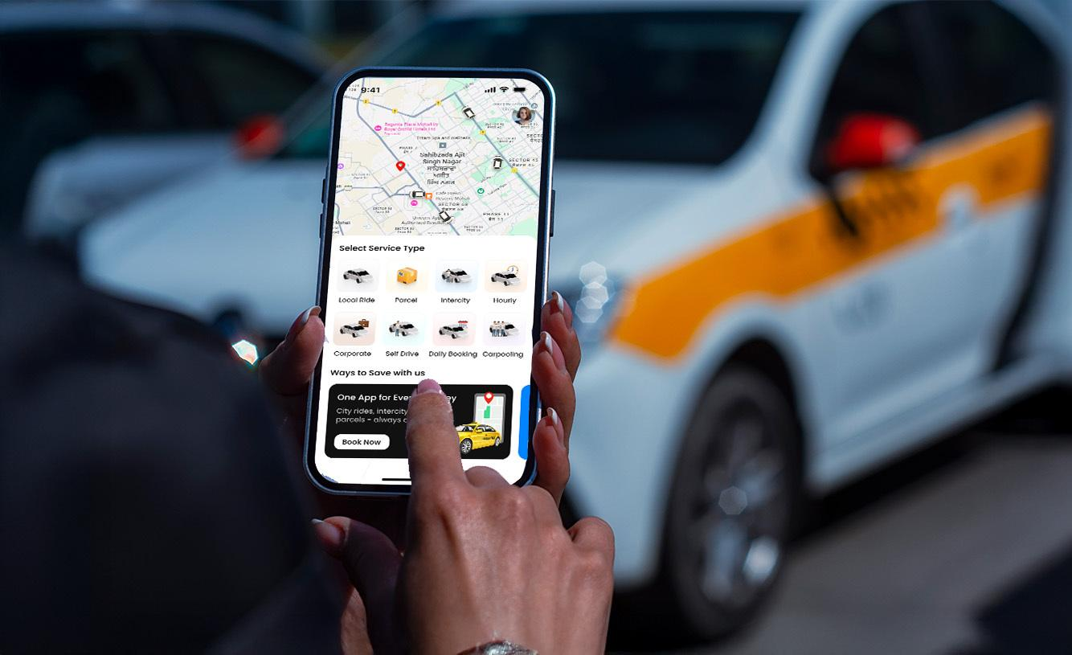
ABOUT
Clonify Now is a forward-thinking technology development company specializing in creating innovative, scalable mobile and web applications. With a focus on solving real-world problems through cutting-edge technology, Clonify Now has established itself as a trusted partner for businesses seeking to enter or expand in digital markets.
CLONIFY OVERVIEW

Slide 4

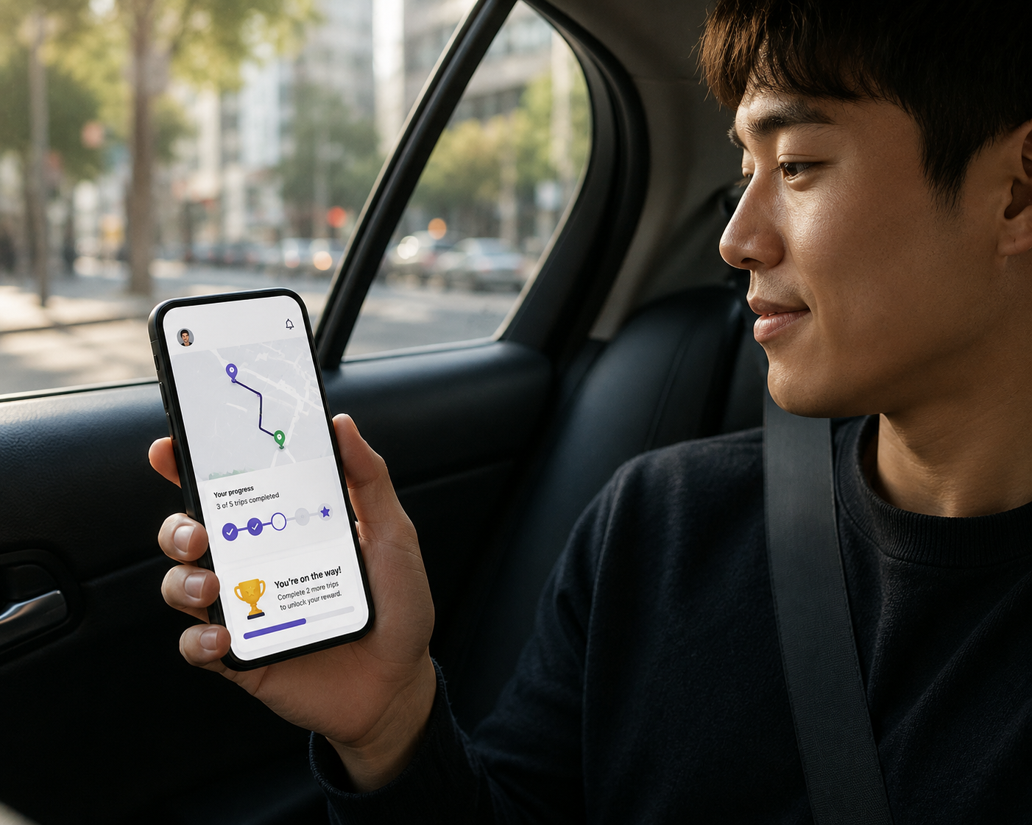
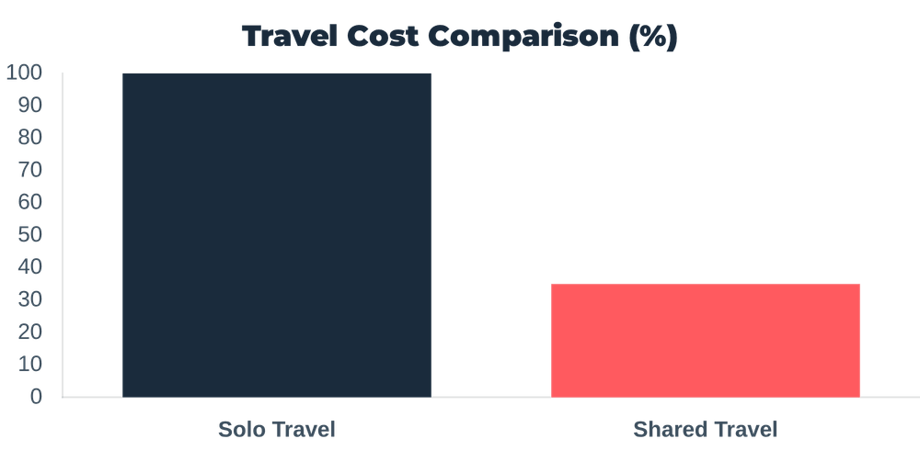
NO REAL-TIME DRIVER AVAILABILITY TRACKING
THE MOBILITY CHALLENGE
WEAK COMMUNICATION SYSTEM BETWEEN RIDER AND DRIVER
POOR TRANSPARENCY IN COST BREAKDOWN FOR SHARED RIDES
INEFFICIENT COORDINATION GAPS
Addressing the inefficiencies and rising costs of modern transportation through shared intelligence.
LACK OF SECURE RIDE-SHARING

Slide 5




Multi-Layered Implementation
SECURITY FRAMEWORK
24/7 real-time monitoring, driver verification protocols, and one-touch emergency alert systems.
SOLUTION ARCHITECTURE
SCALABLE ARCHITECTURE
Modular microservices design with multi-currency and multi-language support for rapid cross-market deployment.
USER-CENTRIC DESIGN
Intuitive UI/UX optimized for low-bandwidth environments and varying digital literacy levels.

Slide 6

Enhanced Security Ecosystem
REAL-TIME GPS TRACKING
AI ANOMALY DETECTION
SAFETY SHIELD
Continuous live location monitoring visible to riders, drivers, and support teams throughout the journey.
Advanced algorithms that automatically detect unusual behavior or significant route deviations.
ACTIVE 24/7
AUTOMATED
SOS EMERGENCY FEATURES
DEDICATED SUPPORT
One-tap emergency alerts to local authorities with automatic location sharing and incident logging.
Specialized safety teams monitoring all rides across multiple time zones for immediate intervention.
GLOBAL TEAM
INSTANT RESPONSE

Slide 7

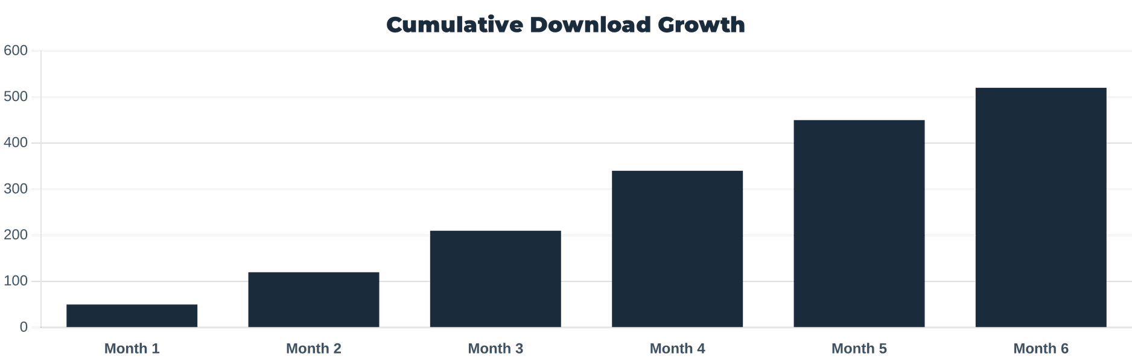
500+ Downloads & Global Adoption
GROWTH METRICS
500+
4.5★
2
TOTAL DOWNLOADS
USER RATING
GLOBAL MARKETS

Slide 8

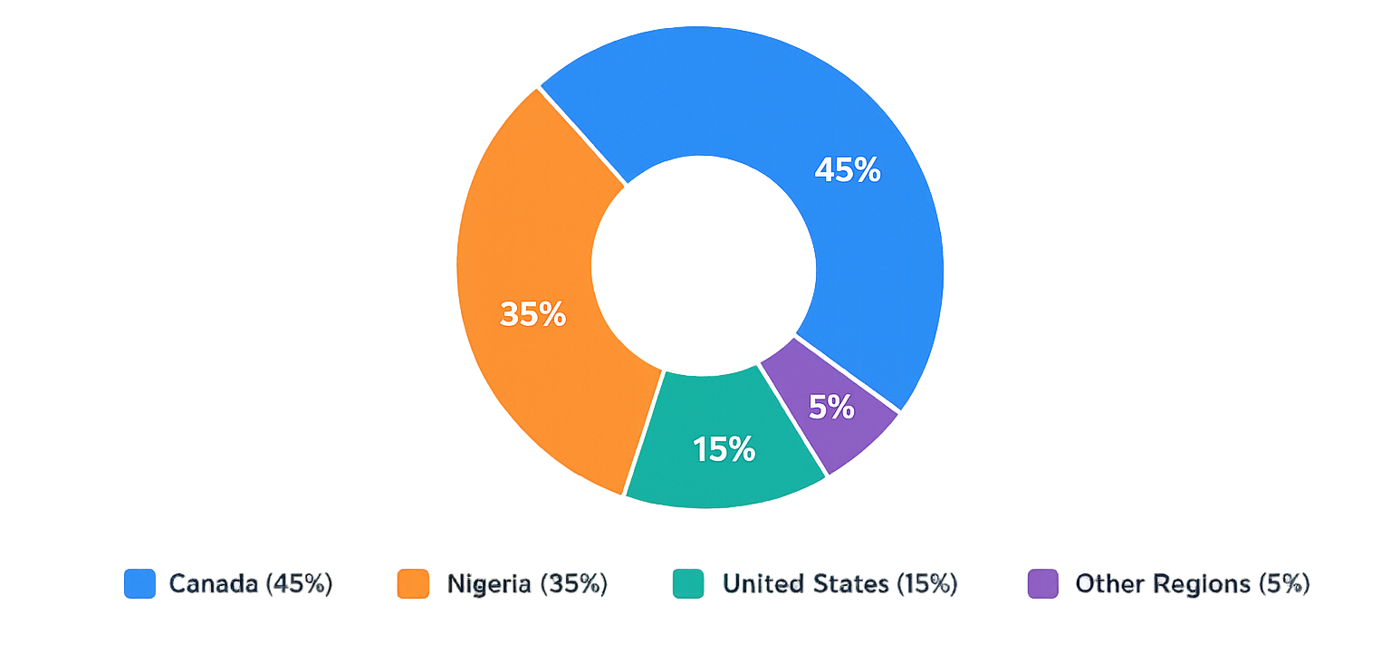
PUDO APP COUNTRY-WISE PRESENCE AND USER REACH
MARKET SUCCESS
Key Highlights
Canada remains one of the primary operational markets for PUDO App.
Nigeria represents a major growth and deployment region for the platform.
The app is also available through the United States App Store, showing international accessibility.
Additional downloads and visibility may come from other regions through Google Play and App Store global accessibility.

Slide 9





SMART ALGORITHMS FOR MAXIMUM EFFICIENCY
GEO-LOCATION LOGIC
NEARBY SUGGESTIONS
OPTIMIZATION
Advanced matching algorithms based on real-time geographical proximity and route alignment.
Intelligent prompts for pickup points that minimize driver detours and maximize convenience.
DYNAMIC ROUTING
REDUCED DEVIATION
Real-time updates and flexible stop management during the trip to handle changing conditions.
Minimizing unnecessary travel time through smart route optimization and passenger grouping.
EFFICIENCY GAINS
Significantly improving ride efficiency and reducing travel deviations.

Slide 10









TRANSPARENCY THROUGH LIVE MONITORING
LIVE LOCATION TRACKING
ACCURATE ETA
Constant monitoring of the vehicle's position throughout the ride for both drivers and passengers.
Predictive arrival times based on live traffic and trip progress data for better coordination.
LIVE TRACKING
NAVIGATION SUPPORT
TRIP PROGRESS UPDATES
Seamless integration with map services for precise driver guidance and route visualization.
Real-time synchronization of journey status to enhance passenger peace of mind and safety.
RIDE STARTED
IN PROGRESS
MID-POINT
APPROACHING
COMPLETED

Slide 11

HIGH-PERFORMANCE TECH STACK
CATEGORY
TECHNOLOGIES & FRAMEWORKS
FRONTEND
Flutter, React Native
ARCHITECTURE
BACKEND
Node.js
DATABASE
MongoDB
CLOUD & INFRA
AWS
APIS & INTEGRATIONS
Google Maps, GPS, Push Notifications, Payment Gateways

Slide 12

DELIVERING MEASURABLE BUSINESS IMPACT
ADOPTION GROWTH
Significant increase in user preference for shared rides over expensive solo travel, driving platform scale and market penetration.
BUSINESS RESULTS
COST REDUCTION
Passengers benefit from lower transportation costs while drivers generate additional income by utilizing empty seats.
IMPROVED SATISFACTION
High user engagement through live tracking, instant notifications, and seamless communication channels.
INCREASED CONFIDENCE
Verified profiles and secure payment systems significantly increased user confidence and platform credibility.

Slide 13

HOW CLONIFY HELPED PUDO SCALE
TECHNICAL EXCELLENCE
Implemented enterprise-grade security and elastic cloud infrastructure that allowed PUDO to handle rapid user growth without downtime.
CLONIFY IMPACT
CONTINUOUS INNOVATION
Established bi-weekly update cycles, integrating direct user feedback into the product roadmap for constant feature optimization.
STRATEGIC LIFECYCLE SUPPORT
Provided ongoing technical oversight and performance monitoring, ensuring the platform remains a market leader in emerging regions.

Slide 14







WHY CHOOSE CLONIFY NOW
PROVEN TRACK RECORD
MARKET EXPERTISE
TECHNICAL EXCELLENCE
Successful deployment across multiple countries with thousands of active users.
Deep understanding of emerging market nuances and regulatory landscapes.
Enterprise-grade security and scalable architecture built for growth.
VALUE PROPOSITION
USER-FIRST PHILOSOPHY
CONTINUOUS INNOVATION
COST-EFFECTIVE
Prioritizing intuitive interfaces that drive high adoption and retention.
Ongoing support and regular updates based on real-time user feedback.
High-quality solutions without the premium price tag of large consultancies.

Slide 15







NEXT STEPS
DRIVING THE FUTURE OF MOBILITY
Launch your scalable mobility platform with our expert team.
STRATEGIC SUMMARY
www.clonifynow.com
Successfully transforming shared mobility through smart technology and user-centric design.
sales@clonifynow.com
+91-9464826889
MARKET POTENTIAL
Meeting the high demand for affordable and sustainable transport solutions in a growing landscape.
PROVEN CAPABILITY
Clonify Now delivers secure, scalable, and high-performance mobility solutions globally.

